Slide 1
Mesh Assertions and Profiles

Slide 2
So far
Have described the components that are used to build the Mesh
The Mesh itself is a thin layer on top.
Mesh Assertions
Are contained in a DARE Envelope
Mesh Profiles
Are a particular type of assertion

Slide 3
Mesh Assertion
Profile
Connection
Contains (all optional)
Names (list of UDF)
Conditions
Notary Token
Updated DateTime
Envelope
Signed

Slide 4
Mesh Profile
Is a self signed Dare Assertion
Contains
Master/Offline Signature Public Key
Used to sign the Mesh Profile itself
Fingerprint of this key is the Mesh fingerprint
List of Administration/Online Signature Public keys
Signs assertions used to manage the personal Mesh
Connection Device assertions
Connection Account assertions

Slide 5
Mesh Personal Profile
Ground truth for the user’s personal Mesh
Is life long, no predetermined expiry
Every Mesh profile

Slide 6
Mesh Device Profile
Ground truth for the device
Lasts the life of the device, is not transferable
Contains a set of base keys bound to the device
Signature
Encryption
Authentication
These keys are only ever used in the process of connecting a device to a Mesh

Slide 7
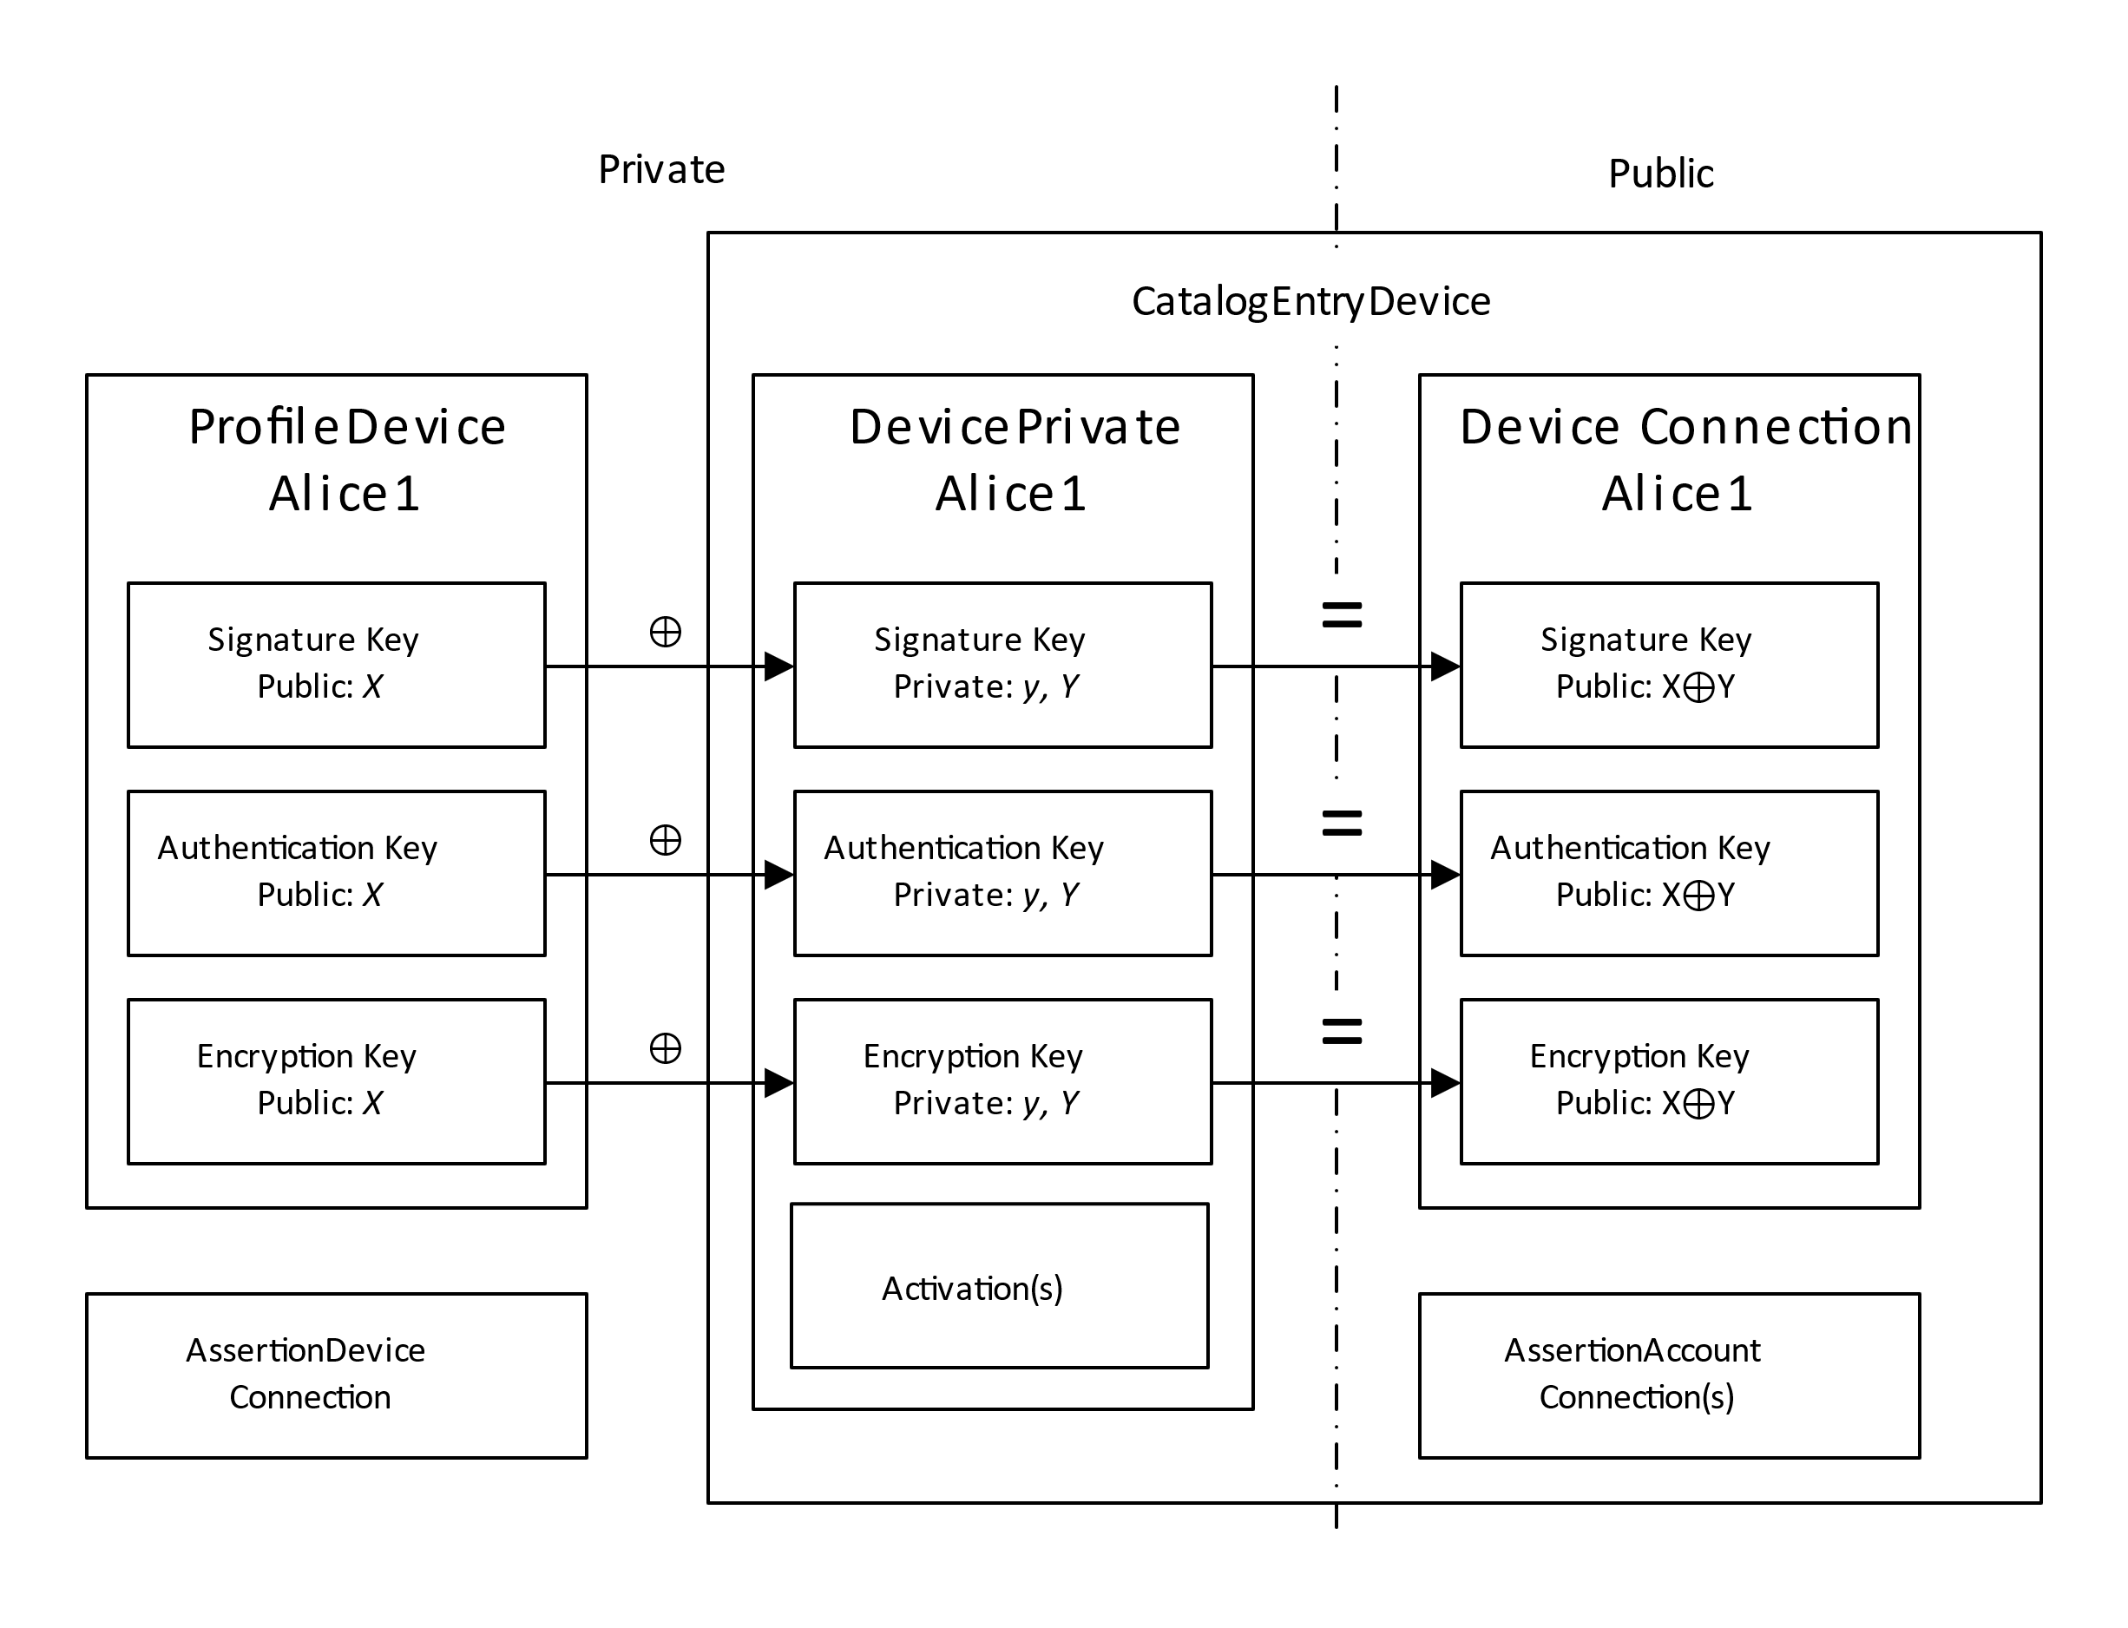

Slide 8
Mesh Account Profile
Ground Truth for a user’s account
May be connected to the Personal Mesh
Is this necessary or desirable
Contains a set of keys used in the context of the Mesh Account
Signature
Encryption
Authentication

Slide 9
Account Activation
Same as connecting the device to the Mesh Profile
There is a lot of cryptography here, why?
The Mesh has no ‘advanced features’
Everyone gets it all.
This makes things simpler
No corner cases to consider
Each layer of isolation requires another layer of keys
We could have built the Mesh with 1995 tech
It would have been too slow to use

Slide 10
Mesh Services
Service Profile
Host Profile
Host Connection

Slide 11
Conclusion
Mesh PKI looks very similar to PKIX except that
It is in JSON
Nothing ever expires
Enable use of hash chain notarization techniques (blockchain)
Every user manages their own root of trust
So it also looks like OpenPGP
Could call it a Web, but World Wide Web was chosen
So reflecting… MMM

